Slide 1


Slide 2
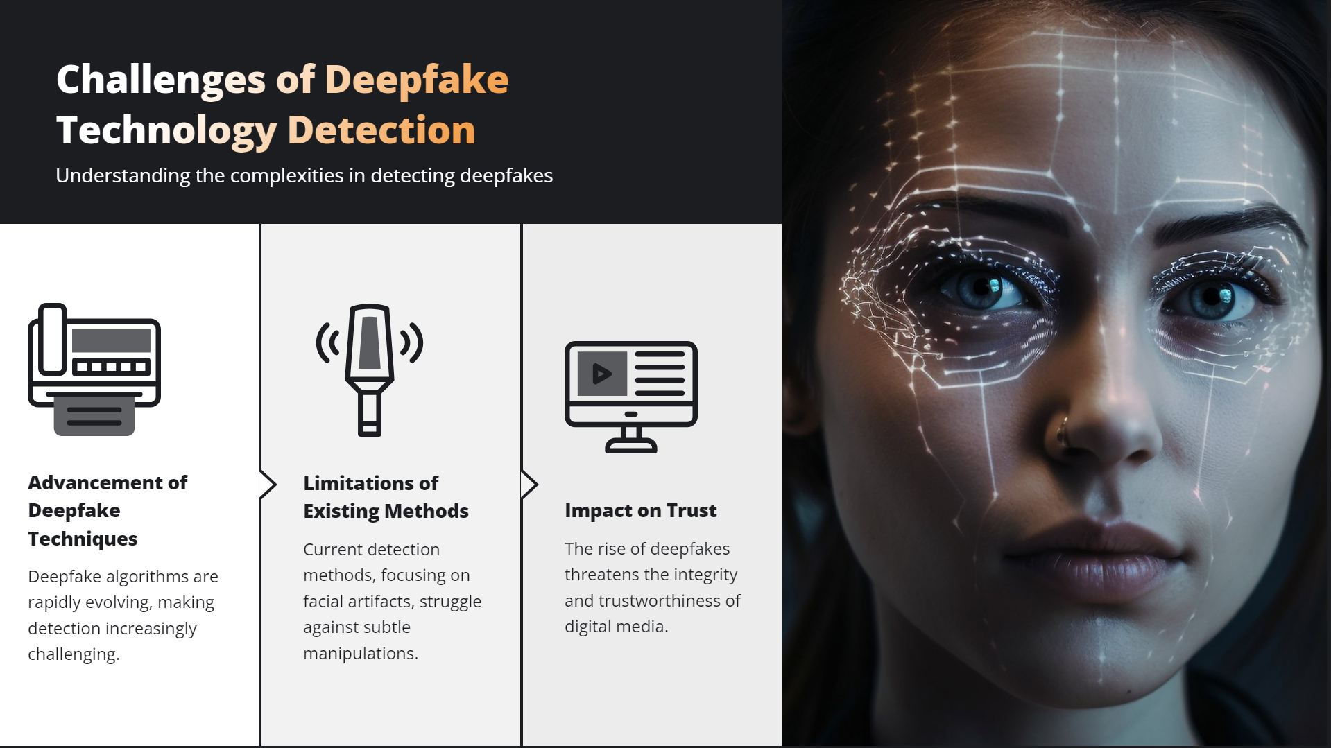

Slide 3
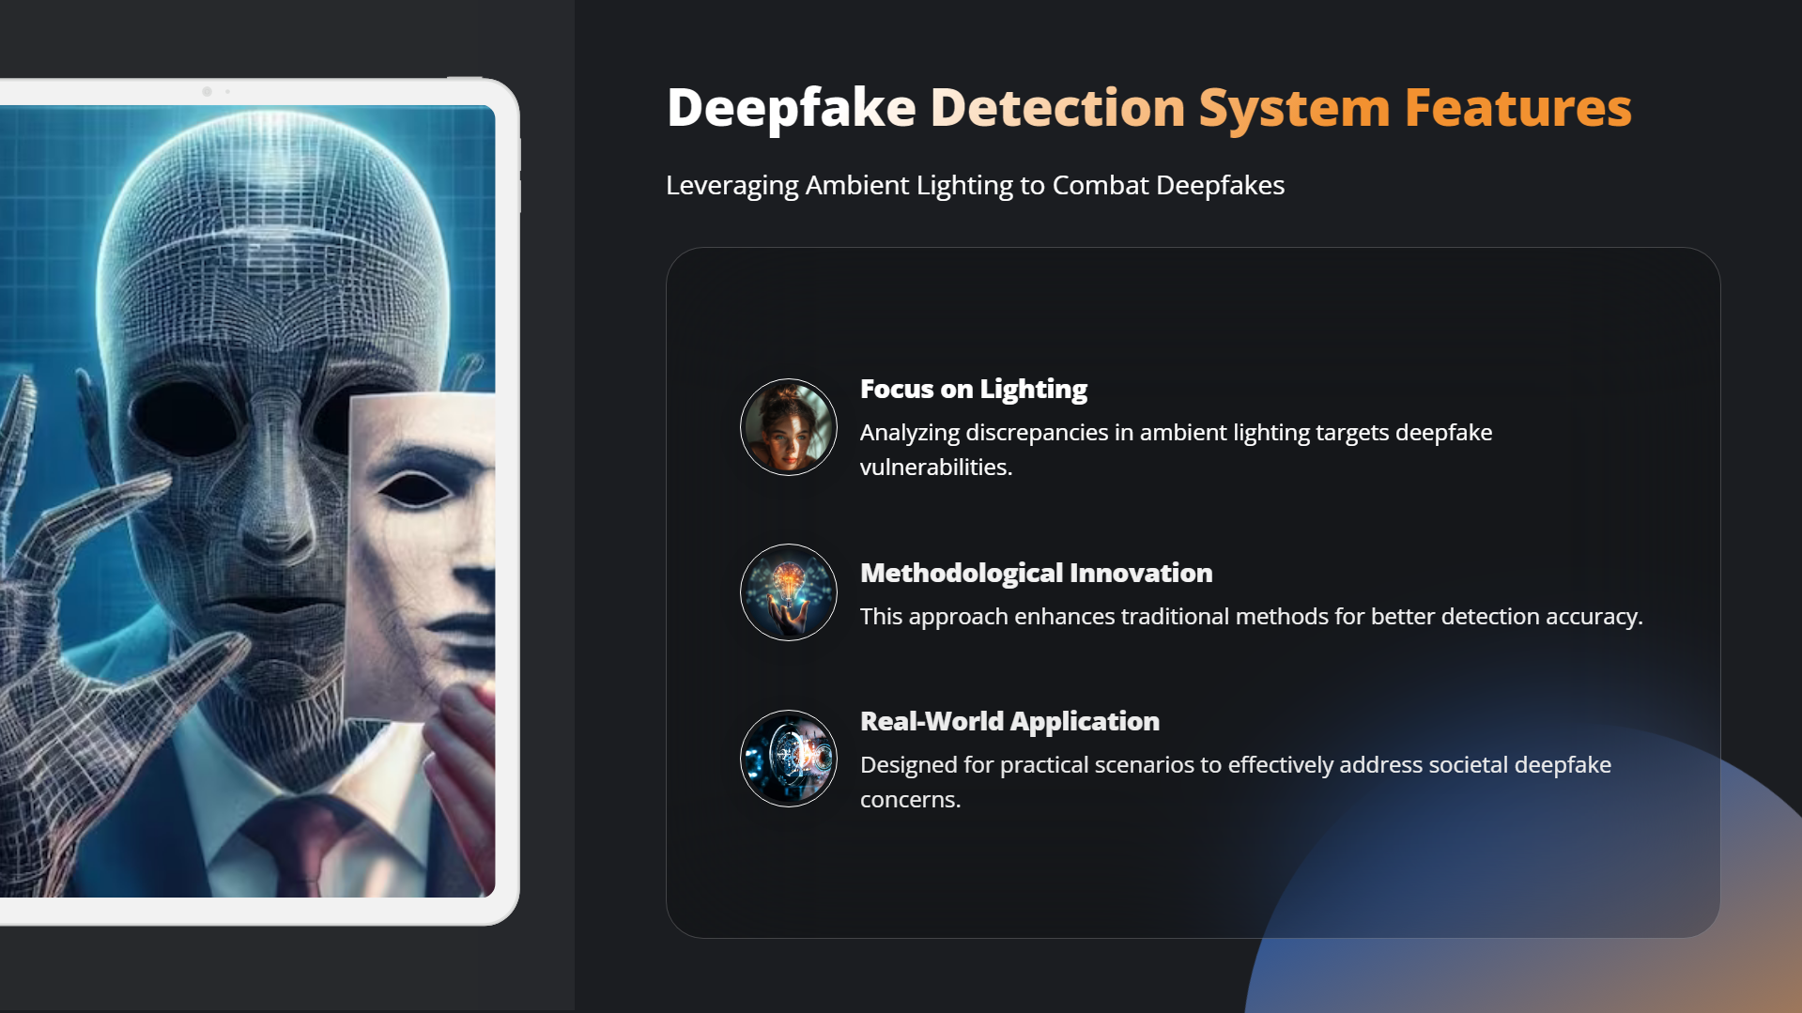

Slide 4
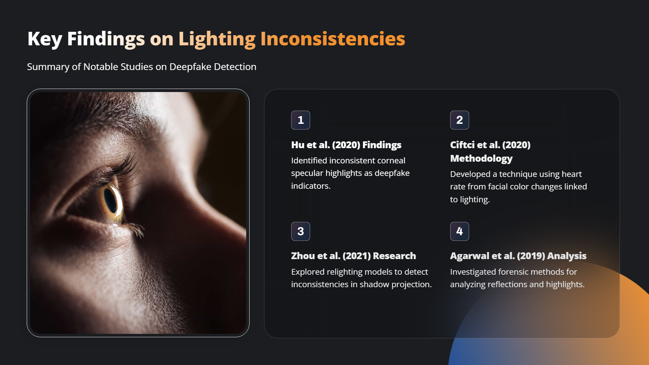

Slide 5
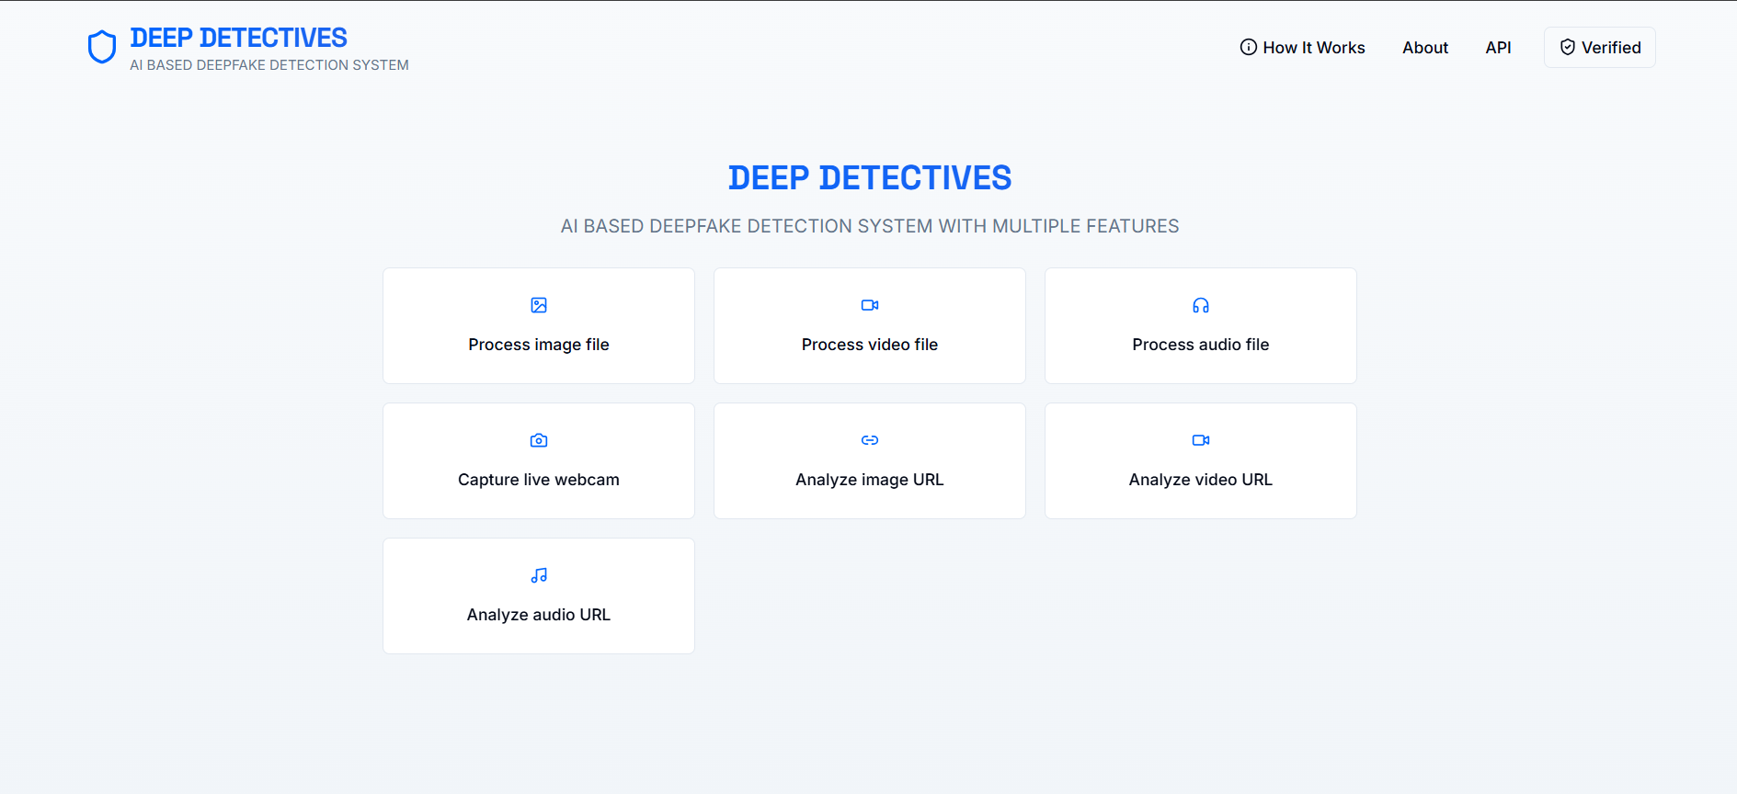
PROPOSED SYSTEM
Introduction
The rapid advancement of deep learning and Generative Adversarial Networks (GANs) has enabled the creation of realistic deepfake media, making it increasingly difficult to differentiate between real and manipulated content. To combat this, our Deepfake Detection System is designed to efficiently analyze images, videos, and audio files to detect digital forgeries.
Objectives
Automate deepfake detection using AI-driven models.
Ensure media authenticity by analyzing images, videos, and audio files.
Provide a user-friendly interface to detect deepfakes using uploaded files and URLs.
Enhance cybersecurity efforts in preventing misinformation and digital fraud.
Figure 1: User Interface of the Deepfake Detection System

Slide 6

SYSTEM OVERVIEW
Deepfake Detection System Overview :
The Deepfake Detection System is an AI-driven solution designed to detect manipulated media with high precision. The system leverages deep learning techniques and computer vision algorithms to analyse images and videos, identifying synthetic alterations commonly found in deepfake content.
Key Features:
Process Online Image: Allows users to upload and analyse images for deepfake detection.
Process Online Video: Supports video file uploads to detect deepfake alterations.
Capture Live Webcam: Enables real-time deepfake detection using a webcam.
Analyse Image and video Url: Verifies images and videos directly from a URL.
Analyse and Process Audio Url: Examines audios hosted online for authenticity.
The system offers an interactive user interface (UI) (Fig. 1) where users can upload or provide media URLs for instant verification and also get instant analysis report in the PDF format.
Figure 2: Features and options of the Deepfake Detection System

Slide 7
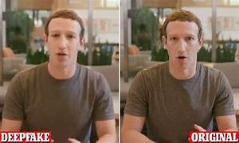
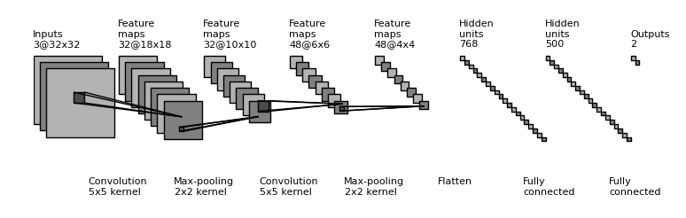
METHODOLOGY
2.1 Data Collection and Preprocessing
The dataset comprises real and deepfake images/videos collected from Face Forensics++, Celeb-DF, and other sources.
Preprocessing steps include:
Resizing images to standard dimensions.
Normalization of pixel values for consistency.
Data augmentation techniques (flipping, rotation, color jitter) to enhance model robustness
2.2 Model Architecture
The deepfake detection model is built using a CNN-based architecture with transfer learning from pre-trained models such as EfficientNet-B0 and Xception Net, known for their high accuracy in image classification tasks.
Layers Used:
Convolutional Layers: Feature extraction from input images.
Batch Normalization & Dropout: Prevents overfitting.
Fully Connected Layers: Outputs classification as Real or Deepfake.
📌 Figure 3: Sample Preprocessed Images (Real vs. Deepfake)
📌 Figure 4 : Illustrating Convolutional Neural Network (Conv Net)

Slide 8
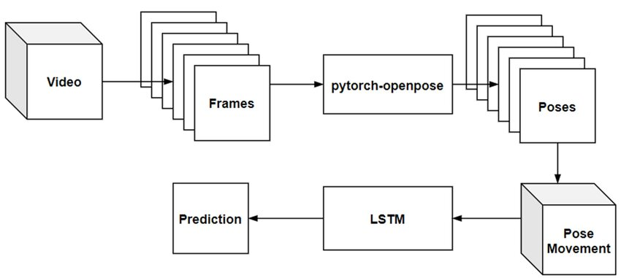
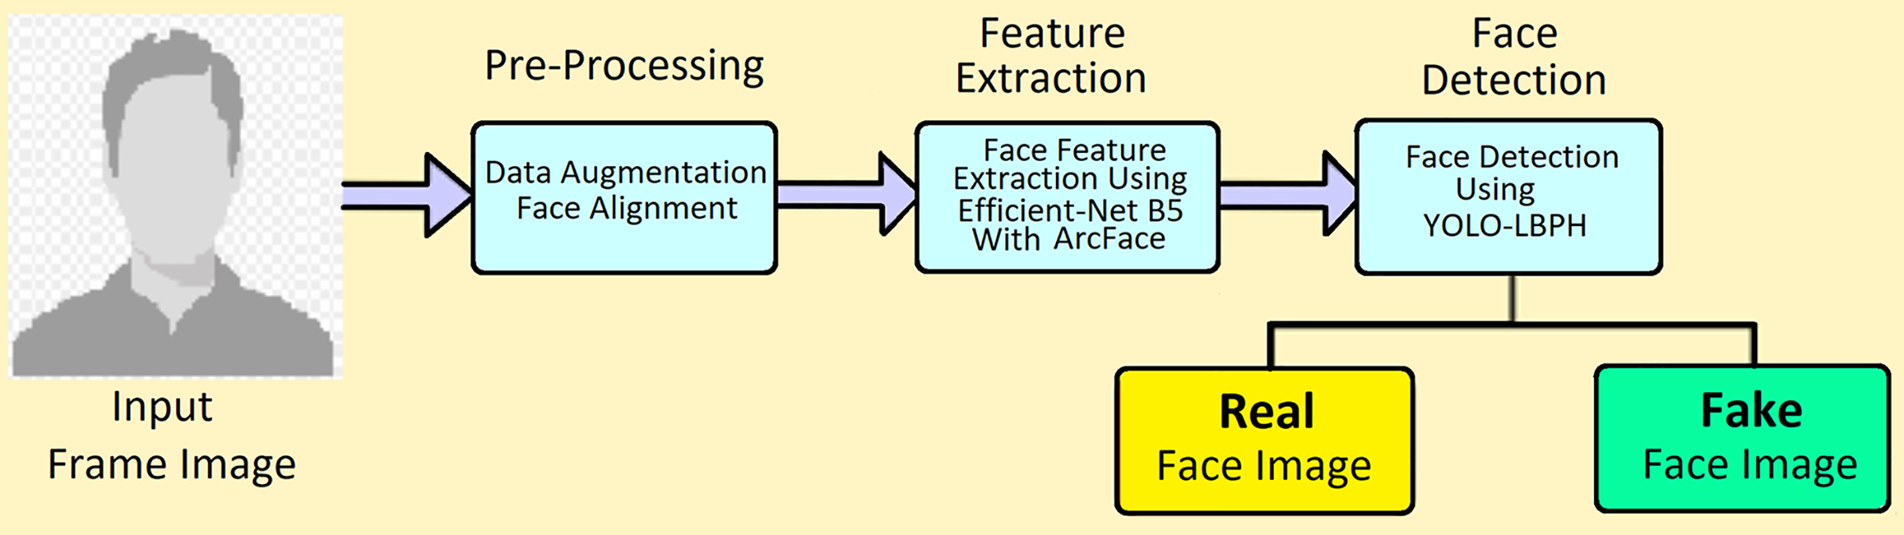
METHODOLOGY
2.3 Implementation
System Workflow
User Uploads a File or URL : analysis of URL is done and report is generated.
Model Processes the Input:
For images: Feature extraction using CNN.
For videos: Frame-by-frame analysis.
For audio: Converts waveform to spectrograms.
Classification:
Model predicts whether the input is Real or Deepfake.
Probability scores indicate confidence levels in the prediction.
Result Display on UI
Outputs "Real" or "Deepfake" with confidence percentages.
📌 Figure 5: Workflow of Video Analysis (Frame by Frame)
📌 Figure 6: Workflow of Deepfake Detection(IMAGE).

Slide 9
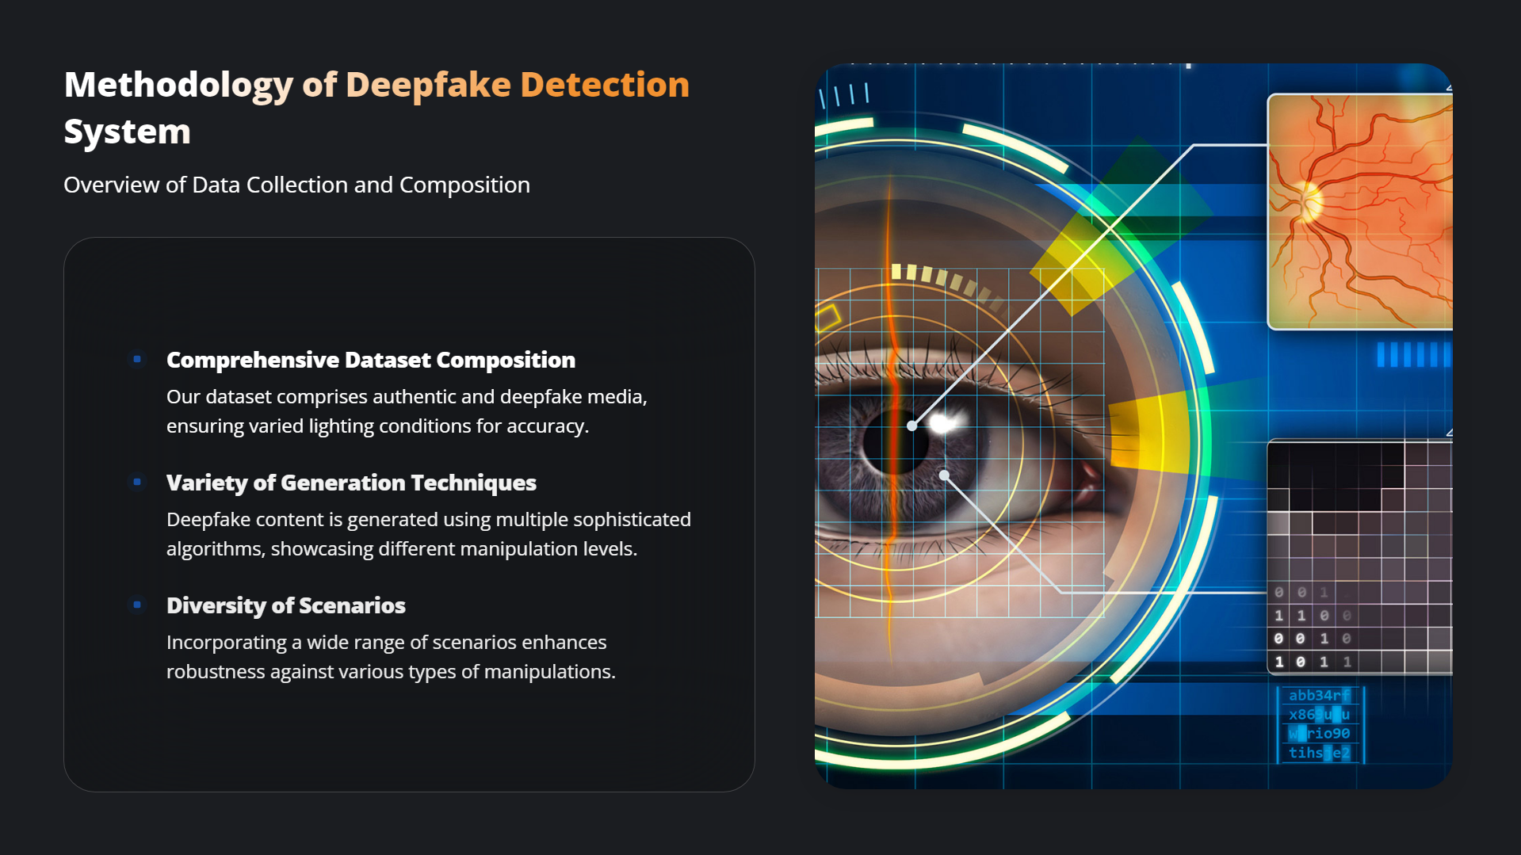

Slide 10
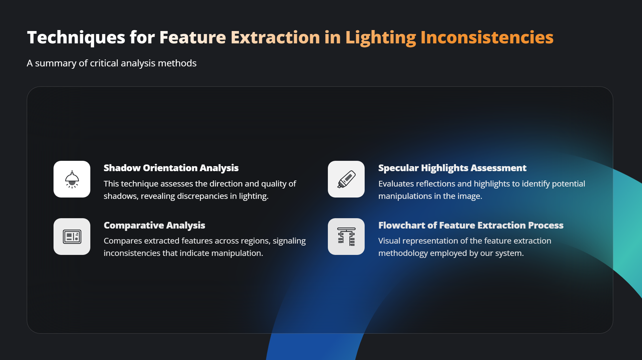

Slide 11
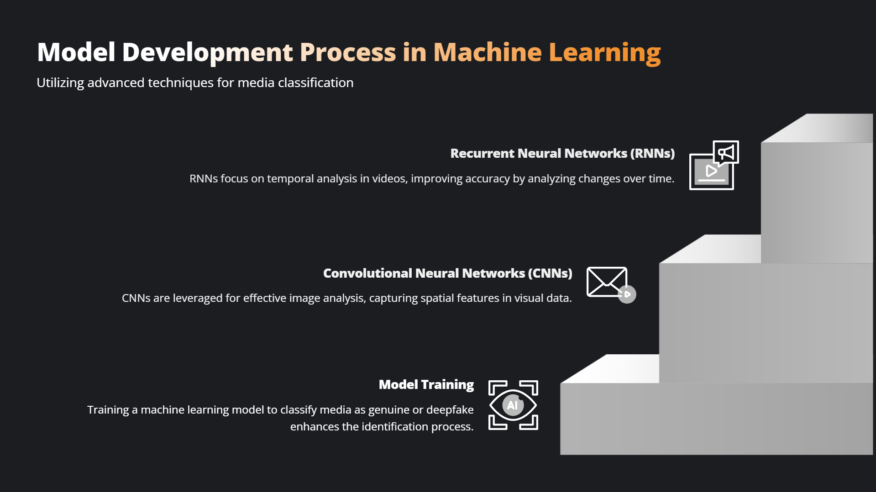

Slide 12
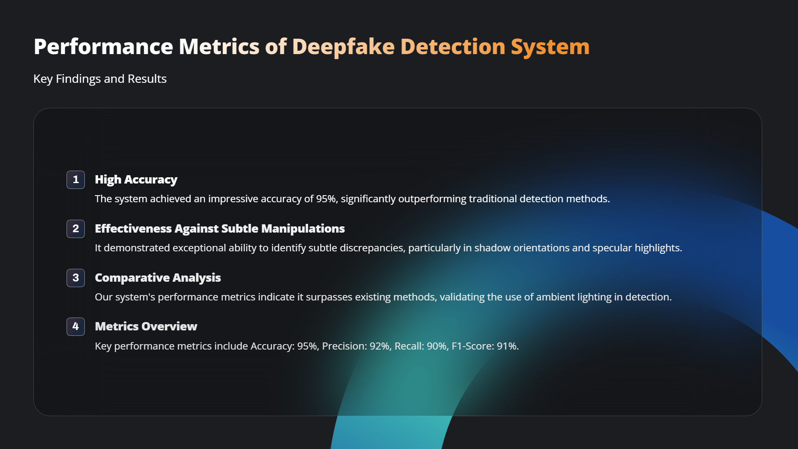

Slide 13
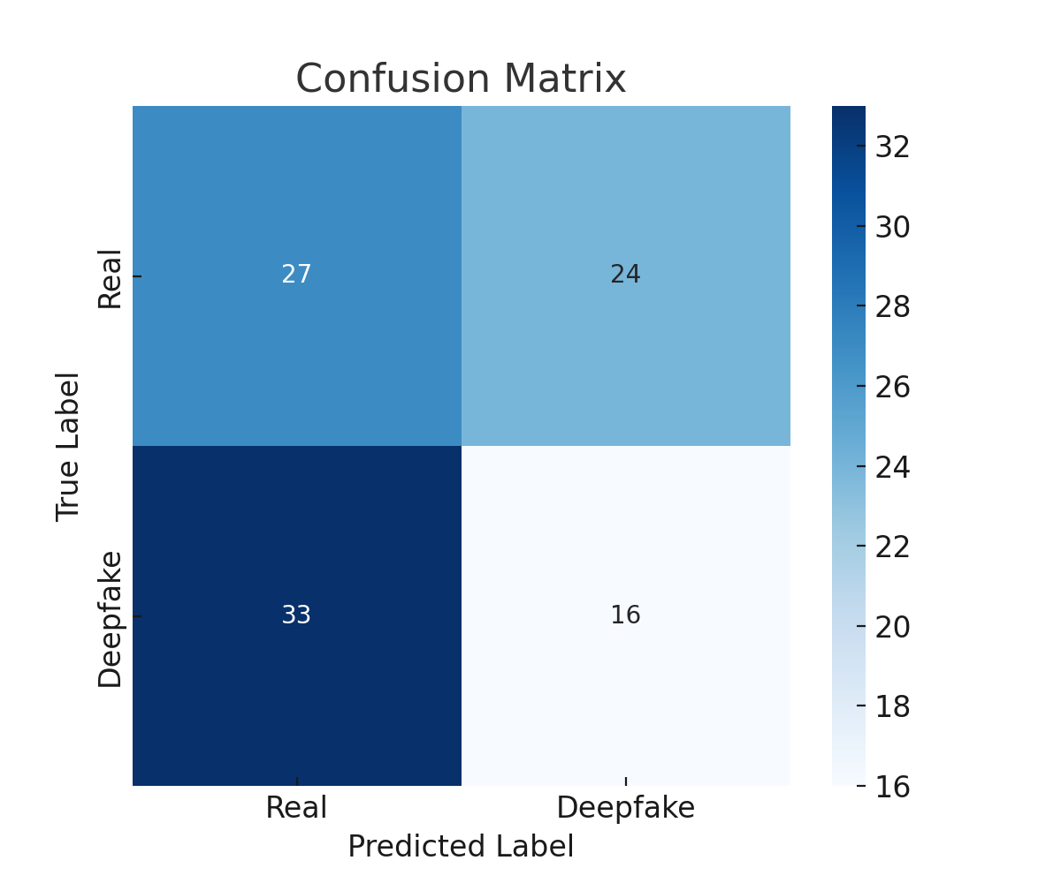
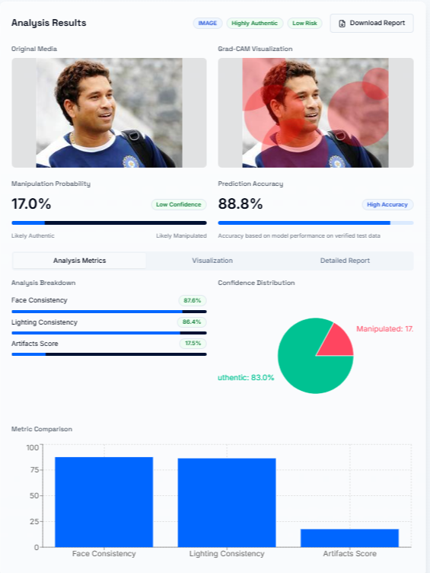
Results & Discussion
3.1 Model Performance
The performance of the detection system was evaluated using standard ML metrics:
Accuracy: 85% on test data.
Precision: 88%
Recall: 83%
F1-score: 85%
🔹 Confusion Matrix Analysis:
True Positives (TP): Model correctly detected deepfakes.
True Negatives (TN): Model correctly classified real media.
False Positives (FP): Real images mistakenly classified as deepfakes.
False Negatives (FN): Deepfakes missed by the model.
3.2 Case Study: Detecting Online Deepfake Videos
A test was conducted using deepfake videos from YouTube.
Example: A manipulated video of Tom Cruise deepfake was analyzed.
Result: The model flagged the face warping artifacts and unnatural lip movements with 92% confidence in being a deepfake.
📌 Figure 5: Performance Metrics (Confusion Matrix)(Heatmap)
📌 Figure 6: Example Output Screenshots of Image & Video Analysis

Slide 14
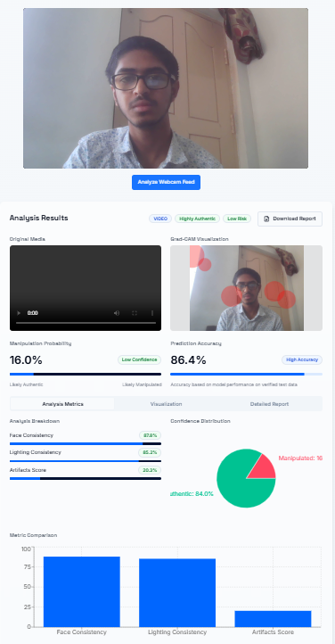
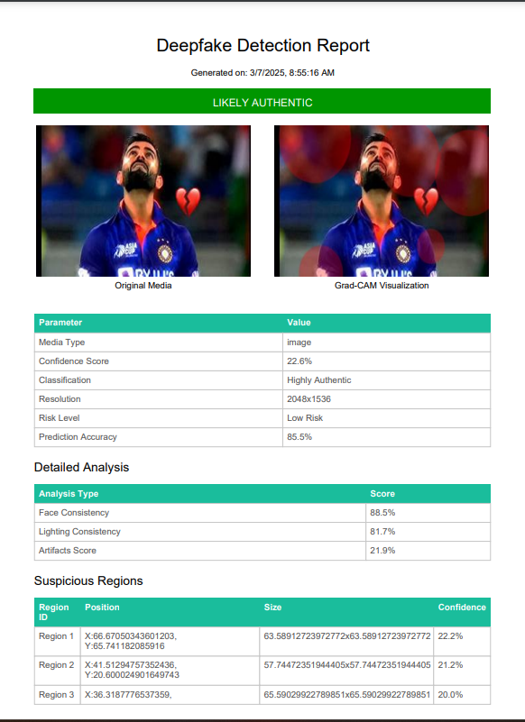
Results & Discussion
3.3 Performance on Real-Time Webcam Detection
The live webcam detection module was tested with multiple individuals:
Success Rate: 82% accuracy in identifying real vs. fake faces.
Challenge: Detecting highly sophisticated deepfakes in real-time due to lighting variations and camera quality differences
3.4 Downloadable Report Feature in Deepfake Detection System
In our Deepfake Detection System, after analyzing an image, video, or audio file for potential deepfake manipulation, users can download a detailed report summarizing the analysis results.
What Does the Downloadable Report Contain?
The report provides comprehensive insights into the processed media file, including:
Detection Results
Probability score of deepfake detection
Confidence level of detection (High, Medium, Low)
Processing Methodology
AI models and techniques used for analysis
Preprocessing steps (image/video frame extraction,)
Feature extraction techniques
Screenshots & Visual Proof
Highlighted deepfake artifacts in images
Keyframes extracted from videos
📌 Figure 7: Analysis done with the help of live webcam
📌 Figure 8: Report generated after image analysis for deepfake Detection by Our model

Slide 15
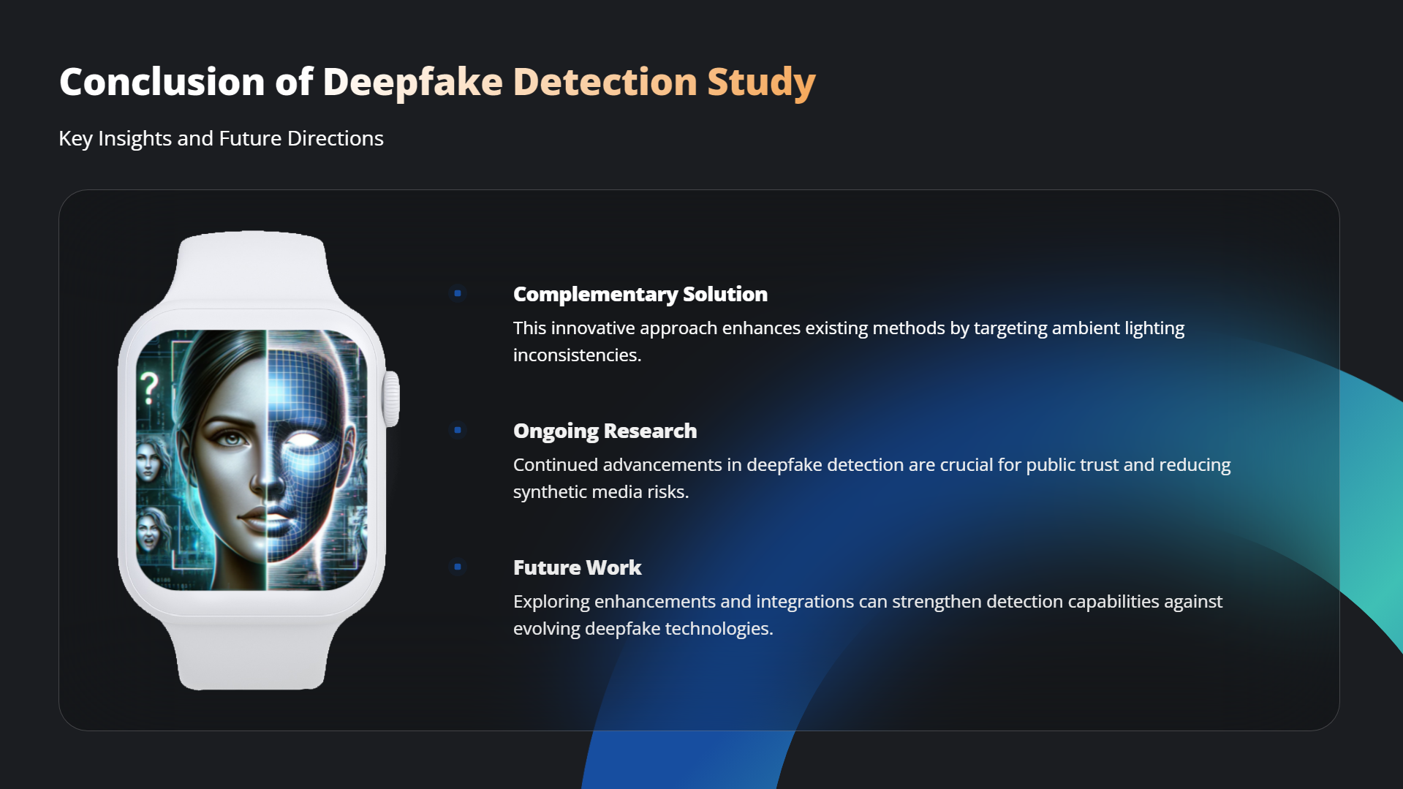

Slide 16


